Slide 1
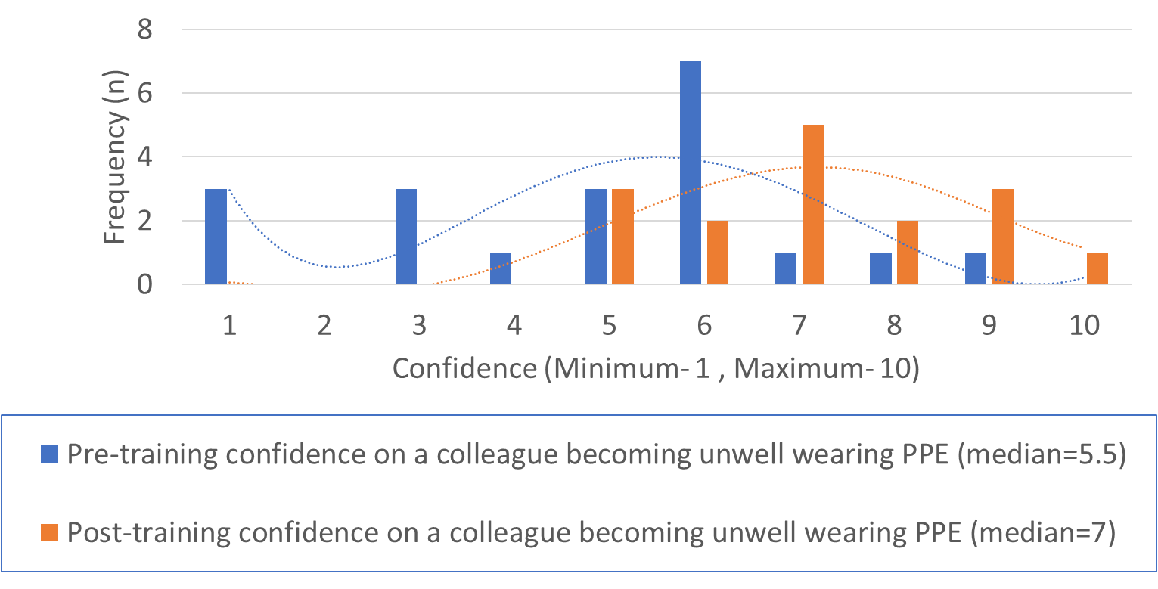
Assessing junior doctor confidence in emergency scenarios following a multi-disciplinary simulation within a theatre environment
Vivek Vaidya¹, Stephen Mowat¹
¹Northumbria Healthcare NHS Foundation Trust Email: vivek.vaidya1@nhs.net
1. Background
3. Methods
Background:
The Royal College of Anaesthetists' recommends the provision of regular multi-disciplinary team (MDT) training as follows:
Chapter 3: Guidelines for the Provision of Anaesthesia Services for Intraoperative Care 2019: 4.2 ^{[1]}
“Theatre teams should undergo regular, multidisciplinary training that promotes teamwork, with a focus on human factors, effective communication and openness”
A theatre team consists of a wide MDT including but not limited to: consultants, junior doctors, mid-wives, nurses, and practitioners.
Junior doctors will have varying experience of this environment depending on their grade and speciality as well as frequent rotations as part of their training.
Hence some will be unfamiliar with the theatre environment or unfamiliar with a new department.
3. Methods:
An anonymous electronic survey was used to assess trainee’s awareness of key equipment in theatre, and confidence when faced with emergency situations. We ran a brief simulation involving the theatre MDT every day for a week. This was guided by a brief vignette with an assigned guideline to facilitate the situation, as demonstrated by Figure 1.
This was repeated after 2 months followed by resurveying.
Figure 3: Trainee confidence levels (x-axis) to a colleague becoming unwell in theatres in PPE (y-axis= frequency (n))
We observed a general improvement to their confidence in their roles in 4/6 of the emergency situations (Local anaesthetic toxicity, Fire in theatre, Theatre Evacuation, Colleague becoming unwell wearing PPE in theatres). Figure 3 illustrates the improvement in trainee confidence to responding to a colleague becoming unwell in PPE. There was no improvement in confidence levels in Anaphylaxis and Malignant Hyperpyrexia.
Figure 1: Vignette for Local Anaesthetic Toxicity and accompanying Emergency Guidelines as found in theatres (displayed on separate sheets during simulation)
4. Results
5. Conclusions
6. Conclusions
Our results show that this training improves trainee confidence & awareness in emergency situations.
Running these frequently is of benefit to the multi-disciplinary team to reinforce prior knowledge in keeping with the Anaesthesia Clinical Services Accreditation recommendations ^{[2]}.
2. Aims:
We set out to assess the impact of these regular MDT training in Junior Doctors within a multi-site trust on their:
Confidence in their roles in a given emergency scenario in theatres
Awareness of the location of emergency equipment (e.g. guidelines, arrest trolley, buzzer) in theatres
2. Aims
7. Acknowledgements
Many thanks to all the theatre staff in Northumbria Healthcare foundation trust for helping facilitate the training.
6. Acknowledgements
We observed an improvement in trainee awareness of the location of emergency equipment (guidelines, arrest trolley, buzzer).Figure 2 illustrates the improvements observed on trainee awareness of the location of the emergency buzzer.
7. References:
[1] https://rcoa.ac.uk/gpas/chapter-3#chapter-4
[2] https://rcoa.ac.uk/sites/default/files/documents/2019-08/ACSA-SelfAssessment-2019.pdf

